Slide 1
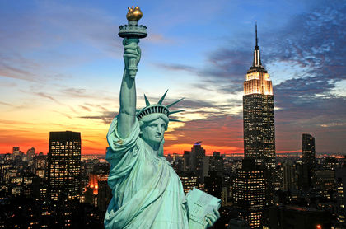
The History of the United States of America

Slide 2
The Algerian Flag

Slide 3
What do you know about it ?

Slide 4
What do you see in the flag ?
How many colours does the flag have ? What are these colors ?
What does each color stand for ?
How many stars do you see? Count them.
How many stripes are there ?

Slide 5
What do the stars represent?
What do the stripes represent?

Slide 10
Presentation made and delivered by:
Mr. Djamil Benelmouffok
Teacher of English & Spanish

